Slide 1
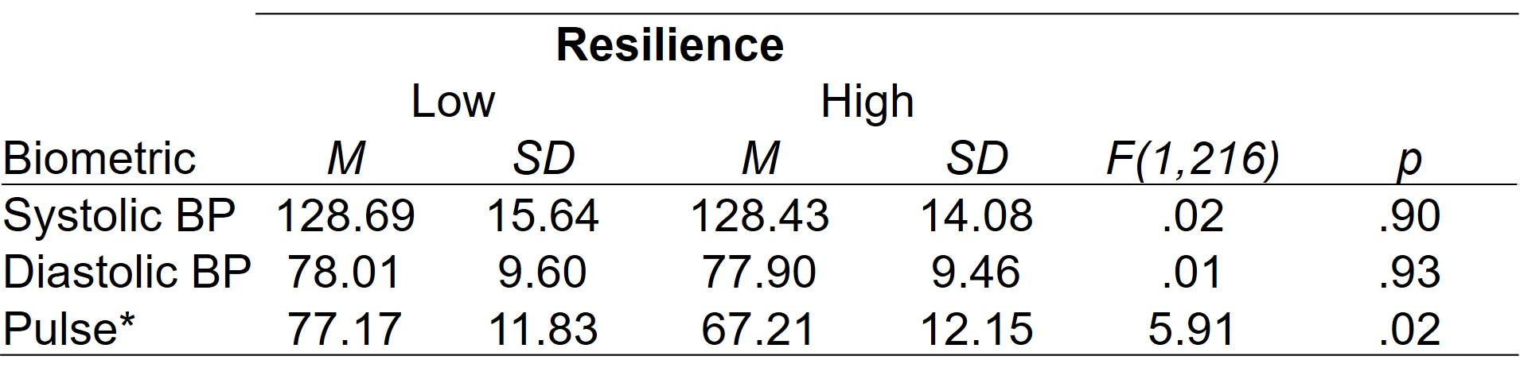
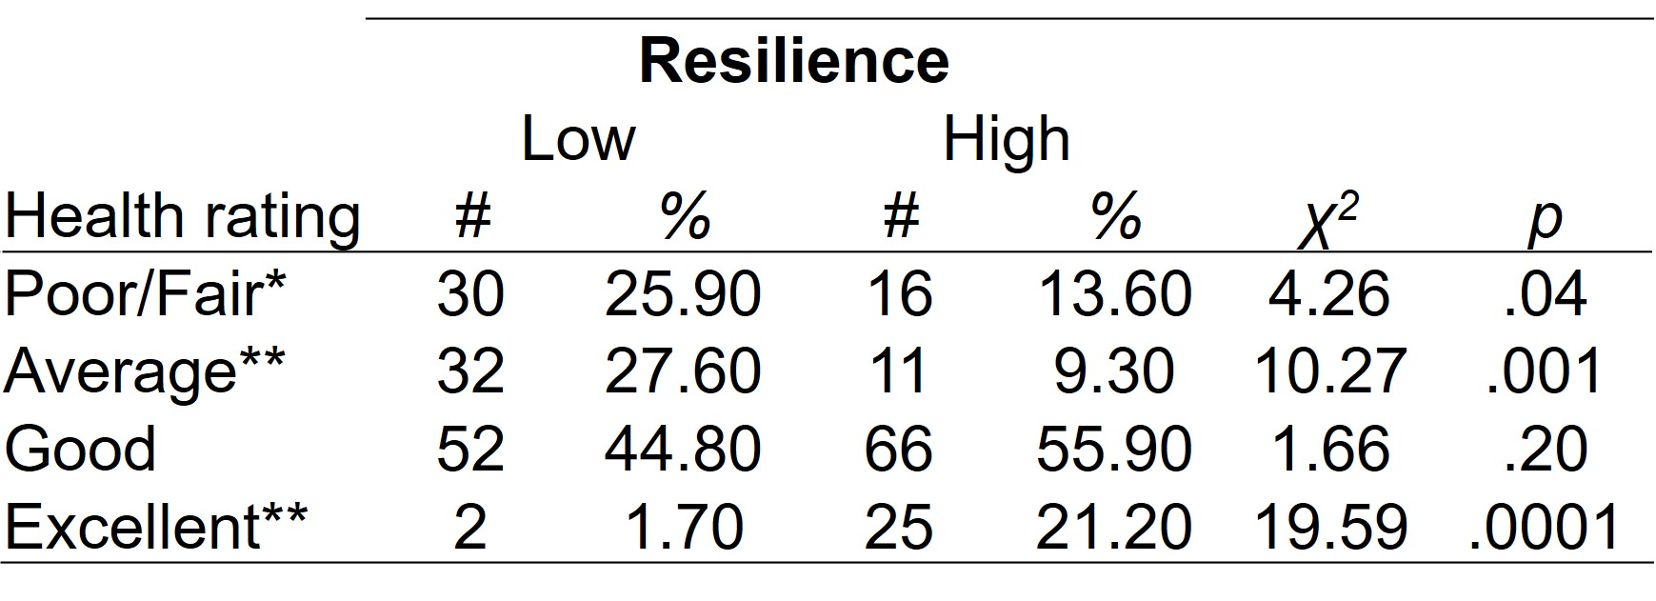
Self-reported Resilience, Somatization, Health, & Health Biomarkers among a Sample of US Military Active Duty & Veterans Valerie J. Rice¹ & Paul J. Schroeder², ¹AMED Field Element, Fort Sam Houston, TX & ²DCS Corp, Alexandria, VA,
Background:
A U.S. military service member needs to have the ability experience traumatic situations and return to full combat functionality, to thrive not just survive. The purpose of this study was to examine the relationships between self-reported resilience and self-reported health and physical somatization, as well as the health biomarkers of blood pressure and pulse.
Methods:
233 active duty and veteran US Military service members completed:
Demographic survey
Resilience Scale (Wagnild & Young, 2011)
Patient Health Questionnaire (somatization) (Kroenke, et al., 2002)
Self-rated health (1= “poor” – 5 =“Excellent”)
Blood pressure & pulse
A median split was used to compare low and high resilient individuals.
Results:
The majority of volunteers were male (53%), Caucasian (53%), college educated (60%), married (57%), and veterans (66%). Volunteer’s average age was 48.06 ± 11.95 years, and the average time-in-service was 15.26 ± 8.64 years.
The median score for all volunteers on the resilience scale was 80.00 (±16.50). The percentage of total scores at/above the median threshold (50.2%) did not differ from those below (49.8%), χ² (1) = .02, p = .90. Thus, the two groups were equally divided.
Resilience: Total scores for the high resilient group were higher than total scores for the low resilient, F (1, 233) = 348.63, p < .01.
Somatization: Low resilient volunteers had more somatic symptom complaints as compared with high resilient volunteers, F (1,231) = 37.13, p < .01.
Self-rated health: High resilient volunteers rated their health higher than the low resilient volunteers, F (1,232) = 28.70, p < .01.
Table 1. Self-rated health among the two resilience groups
Note. *p < .05, **p < .01.Data from 7 volunteers that rated their health as “poor” were combined with data from volunteers that rated their health as “fair”.
Although high resilient volunteers were more likely to rate their health as “excellent”, p < .01, and low resilient volunteers were more likely to rate their health as “fair” or “average”, p’s < .05, an equal number of high and low resilient volunteers rated their health as “good”, p > .05.
Health biomarkers: Separate one-way ANOVA’s revealed that, although blood pressure was not different between the two resilience groups, p’s > .05, the low resilient group had higher pulse than the high resilient group, F (1, 216) = 5.91, p < .02.
Table 2. Health biomarkers for two resilience groups
Note. *p < .05. BP = blood pressure
Correlations: Resilience was significantly correlated with health ratings (r = .46, p < .01), somatization (r = -.42, p < .01) and pulse (r = -.18, p < .01) but not blood pressure, p’s > .05.
Conclusions:
Volunteers with higher resilience also had higher self-reported health ratings, lower somatization, and a lower pulse, but no difference in blood pressure. However, the relationship with self-reported health was non-linear as self-rated “good” health was not different between low and high resilient individuals. Taken collectively, these findings support previous findings associating trait resilience with physical health, and provide new information associating resilience with fewer somatization symptoms. Future studies should examine the relationship between resilience and blood pressure among less homogeneous samples.

